Slide 1

COCA COLA STOCK MARKET ANALYSIS

Slide 2

About :- “”” The Coca-Cola Company is an North American multinational beverage corporation incorporated under Delaware's General Corporation Law[a] and headquartered in Atlanta, Georgia. The Coca-Cola Company has interests in the manufacturing, retailing, and marketing of non-alcoholic beverage concentrates and syrups, and alcoholic beverages. The company produces Coca-Cola, the sugary drink for which it is best known for, invented in 1886 by pharmacist John Stith Pemberton. At the time, the product was made with coca leaves, which added an amount of cocaine to the drink, and with kola nuts, which added caffeine, so that the coca and the kola together provided a stimulative effect. This stimulative effect is the reason the drink was sold to the public as a healthy "tonic", and the coca and the kola are also the source of the name of the product and of the company. In 1889, the formula and brand were sold for $2,300 (roughly $68,000 in 2021) to Asa Griggs Candler, who incorporated The Coca-Cola Company in Atlanta in 1892. Since 1919, Coca-Cola has been a publicly traded company. Its stock is listed on the New York Stock Exchange under the ticker symbol "KO". One share of stock purchased in 1919 for $40, with all dividends reinvested, would have been worth $9.8 million in 2012, a 10.7% annual increase adjusted for inflation. A predecessor bank of SunTrust received $100,000 for underwriting Coca-Cola's 1919 public offering; the bank sold that stock for over $2 billion in 2012. In 1987, Coca-Cola once again became one of the 30 stocks which makes up the Dow Jones Industrial Average, which is commonly referenced as a proxy for stock market performance; it had previously been a Dow stock from 1932 to 1935. Coca-Cola has paid a dividend since 1920 and, as of 2019, had increased it each year for 57 years straight.”””

Slide 3
Data Description:
Date : The trading day for which the data is recorded.
Open : The price at which Coca-Cola’s stock started trading on that day.
High : The highest price the stock reached during the day.
Low : The lowest price the stock reached during the day.
Close : The final price of Coca-Cola’s stock when the market closed.
Volume : The total number of Coca-Cola shares traded that day.
Dividends : The amount paid per share to shareholders, if any, on that date.
Stock Split :If there was a stock split, the ratio would appear here.

Slide 4
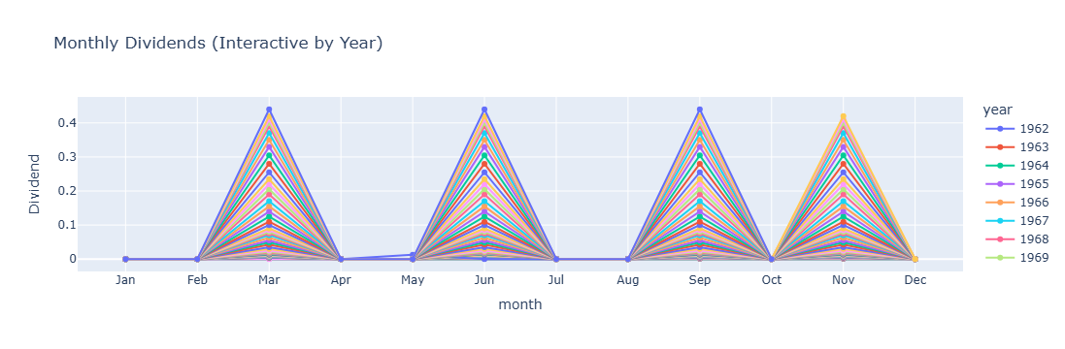
The average stock Dividends of every month from 1960 to 2022 we have taken , so we can know about the pattern of increase.
Result:- The months (March, June, September, November) are often quarter-ending or strategic planning periods, which might explain spikes in activity depending on the context. These are ends of Q1, Q2, Q3, and close to year-end—common times for reporting, reviews, and spending.

Slide 5
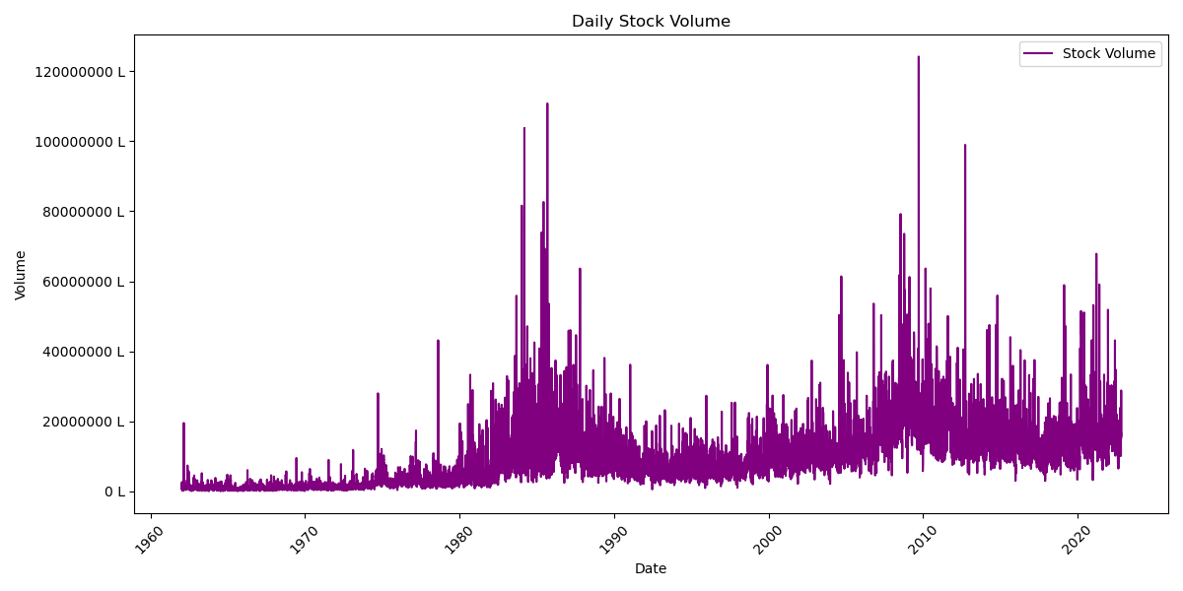
We are know that relationship between the stock split and volume
Result: -
From 1980 to 1990 due to the split of shares into 3 times, the raise of volume we can seen

Slide 6
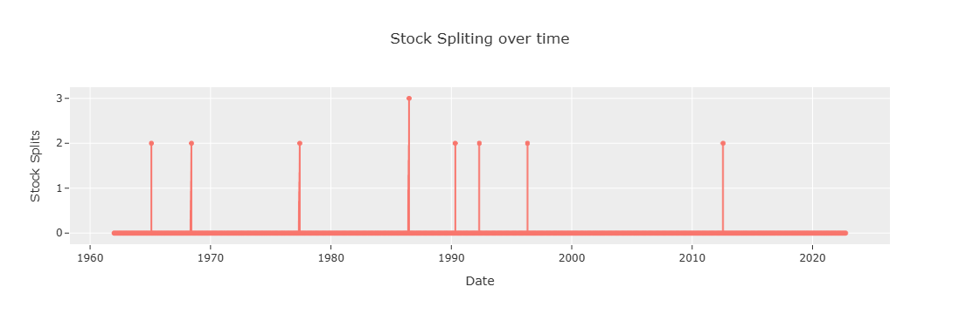
Splitting of Stocks
Stocks splits into 2 for the year with Close price
1965 -0.08 1968-0.17 1977-0.21 1990-2.47 1992-5.22 1996-11.13 2012-28.50 and splits into 3 on 1986-1.14. from the above we can know that as stock price increase
the stock is split to reduce increase the stock buying
capacities and increasing the as rule of
Lower share price = more people trading = higher liquidity.

Slide 7
Why we should take the Rolling Window in the data
A rolling average (also called moving average) is used to smooth out short-term
fluctuations and highlight longer-term trends or cycles in data.
Noise Reduction: Removes sudden spikes or drops that may be outliers.
Trend Analysis: Helps in identifying overall patterns over time.
Time Series Forecasting: Acts as a feature for models to learn better.
Comparative Insight: Easy to compare recent data to past average behavior.

Slide 8
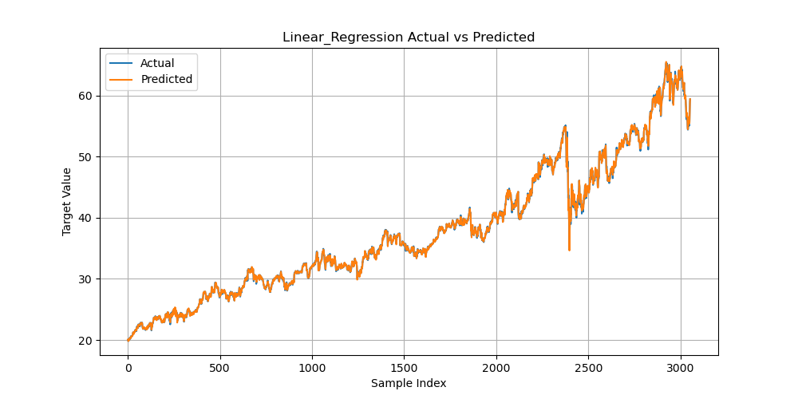
Model Used : Linear Regression
Result: - The model has trained well, here we can see the different of predicted and actual values of closed
price.
The results of model evaluation is
Mean Squared Error: 0.03772740855605178
Mean Absolute Error: 0.13055883250497455

Slide 9
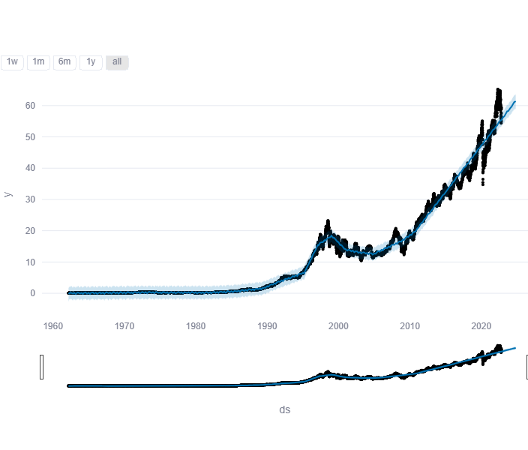
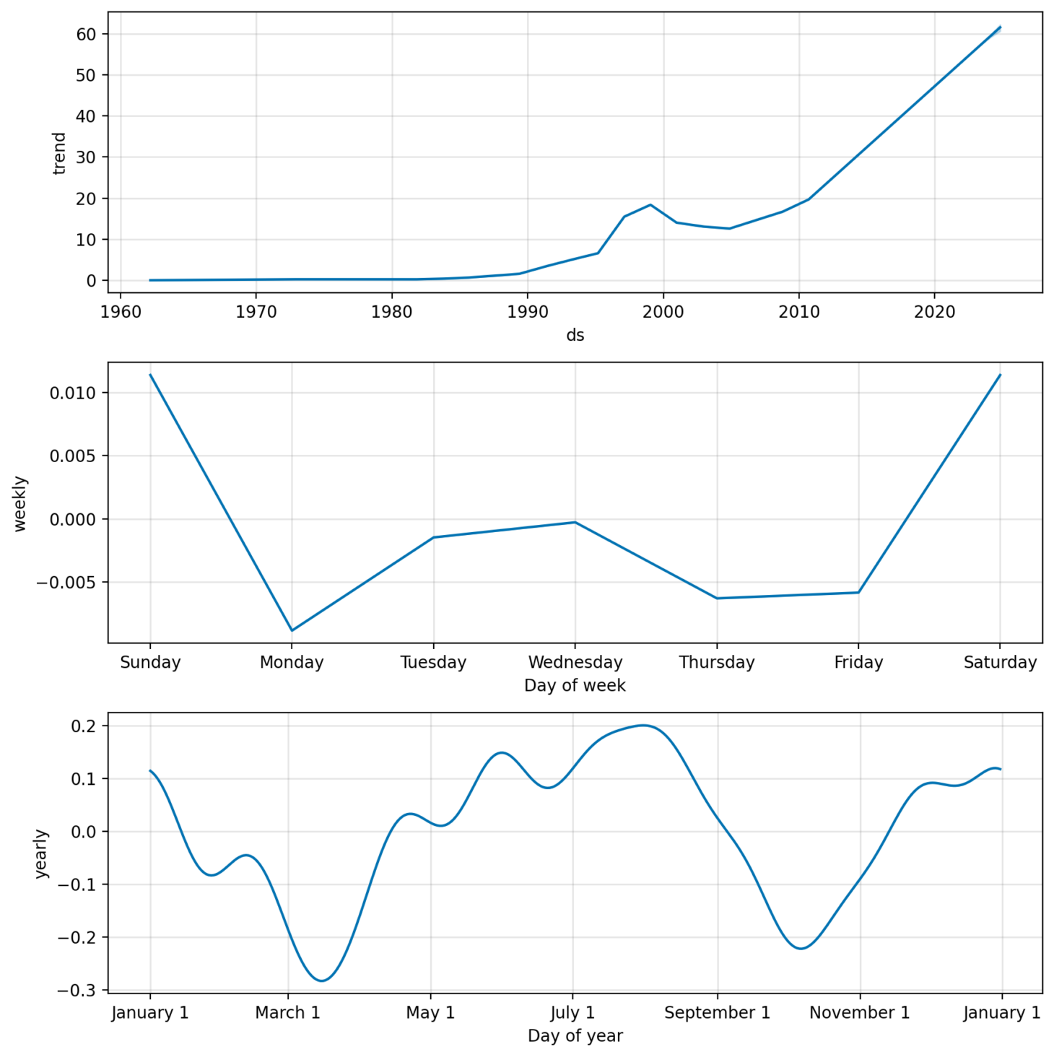
We developed an interactive web-based dashboard using Streamlit to analyze and forecast
Coca-Cola's stock prices.
The tool integrates historical stock data, visualizations, and predictive modeling in a
user-friendly interface.
Our model predicts Coca-Cola's future stock prices based on historical data and seasonality.
The prediction feature helps investors visualize expected trends over the next 4 years.

